Slide 2
Secure File Transfer using Sockets Project id- 8 Submitted by:- Harshpreet Singh Sandhu (Enroll No. R134218065) Neelesh Kumar (Enroll. No. R134218102) Naman Sharma (Enroll. No. R134218099) Aarohi Mangal (Enroll. No. R134218001) Under the guidance of Mr. Keshav Kaushik Department of Systemics

Slide 3
PROBLEM STATEMENT
Creating a GUI-based Secure File Transfer System using Sockets in order to protect users’ privacy & generating malware analysis report of the file.

Slide 4
OBJECTIVES
Display Welcome window including options like login/signup, Send/Receive file, generate malware report and track activity.
Forget password provision is also provided using real time OTP verification.
After Authenticating and Authorizing user, give privilege to download files.
Generate Malware Analysis report of the file
Record all the activities of the users for feasible database collection.

Slide 5
ABSTRACT
This project is on a GUI-based file transfer program by the use of sockets. As sockets provide security to the data by encrypting the link of communication between a web server and browser so that data will be free from man-in-the-middle attacks.

Slide 6
Authentication and Authorisation
Authentication is the process that confirms a user’s identity and provides access to sensitive information..
Authorisation is the next step in the login process, which determines what a user is able to do and see on your website..
It’s Need
Ensure users can access and modify only what they need to.
Maintains user privileges
Ensures privacy
Protects data across devices

Slide 7
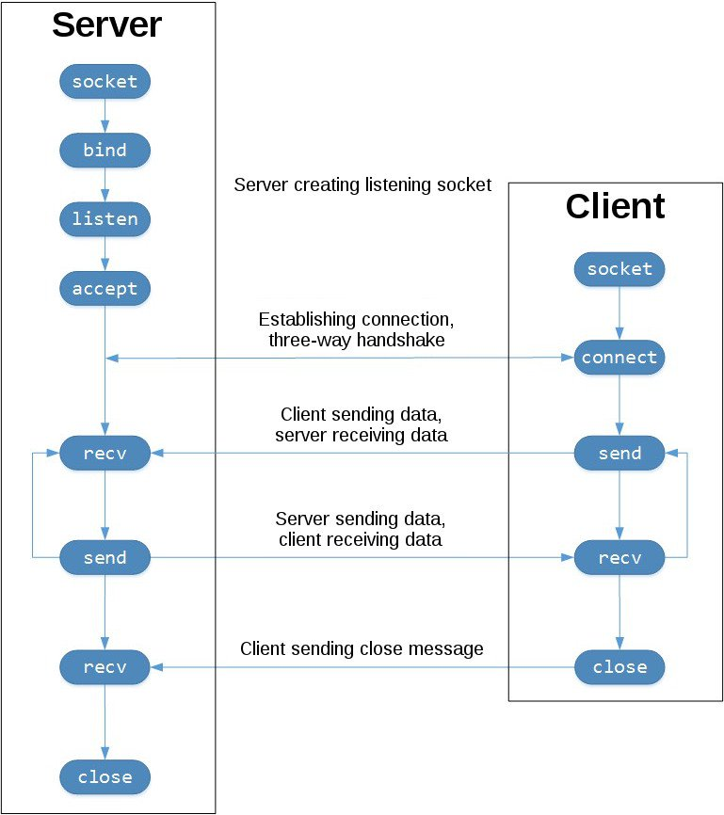
Technologies used
Socket Programming:
A socket serves as an endpoint of a two-way communication link between two programs for sending and receiving data across the network. It provides security to the data by encrypting the link of communication between a web server and browser. In this way, the privacy of the users will not be hampered.

Slide 8
Twilio:
It allows software developers to programmatically make and receive phone calls, send and receive text messages, and perform other communication functions using its web service APIs.
Tkinter:
It is the standard library for Python. Python when combined with Tkinter provides a fast and easy way to create object oriented interface to the GUI toolkit.

Slide 9
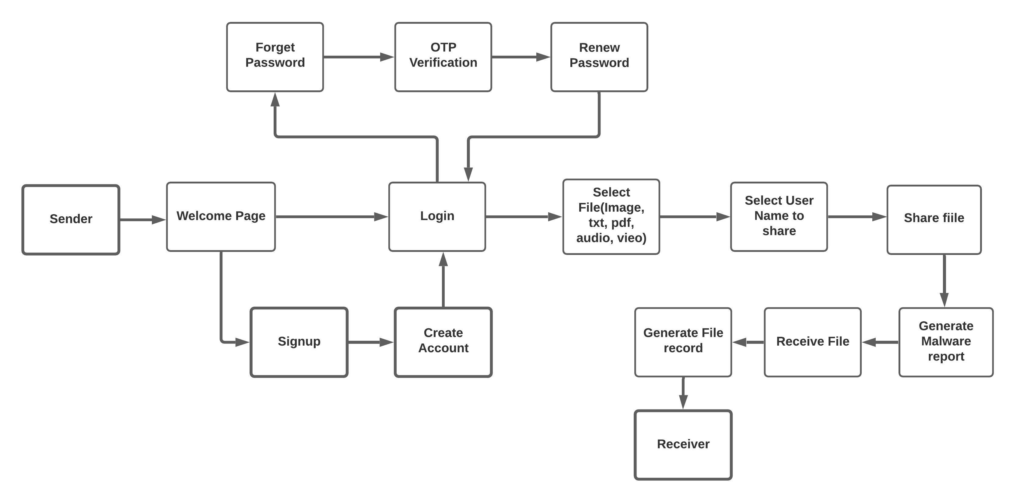
Workflow

Slide 10
Windows
Welcome
Login
Signup
Verification
File transferring

Slide 11
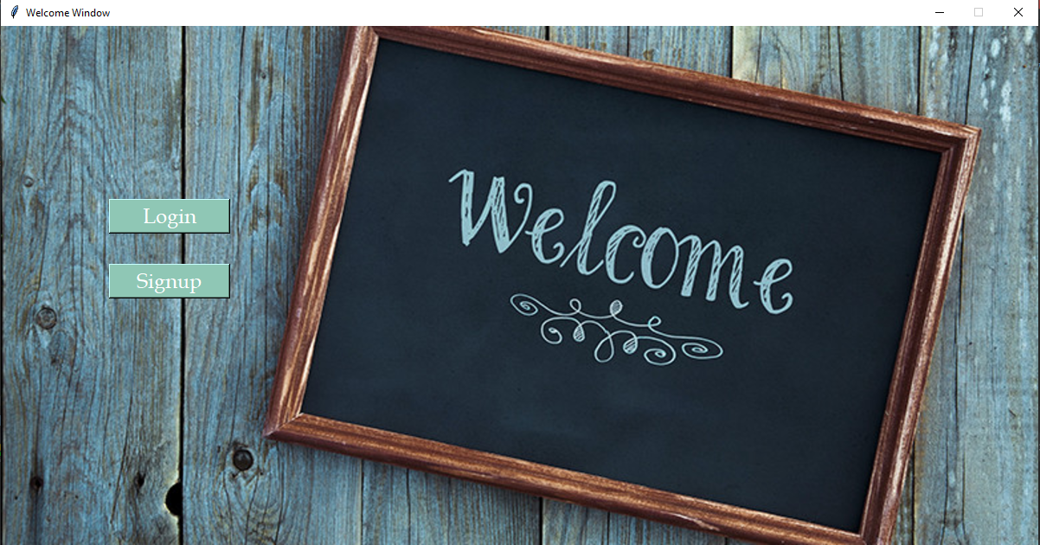
Welcome Window

Slide 12
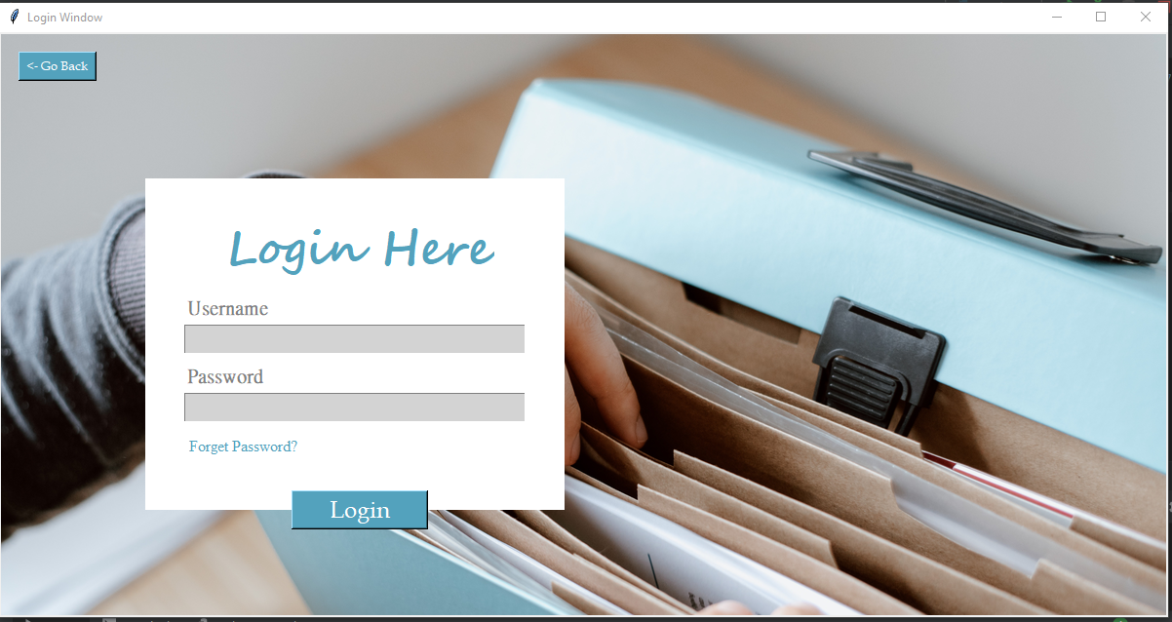
Login Window

Slide 13
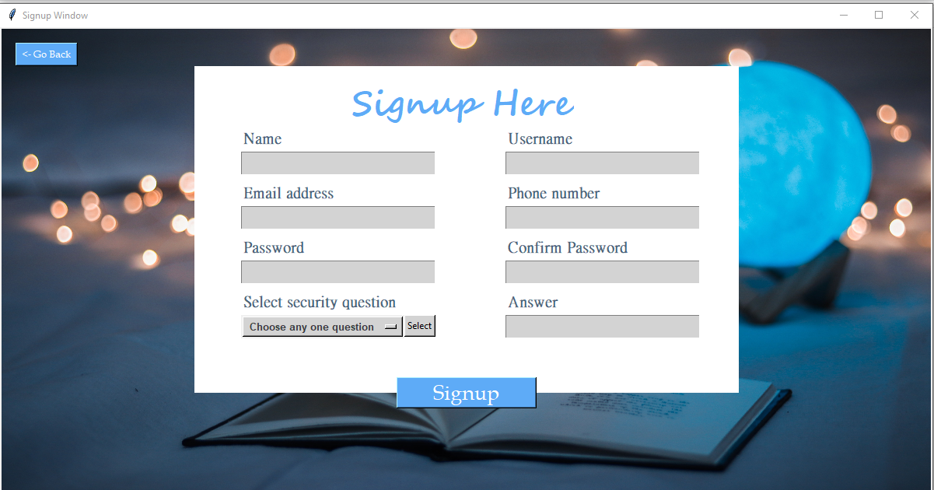
Signup Window

Slide 14
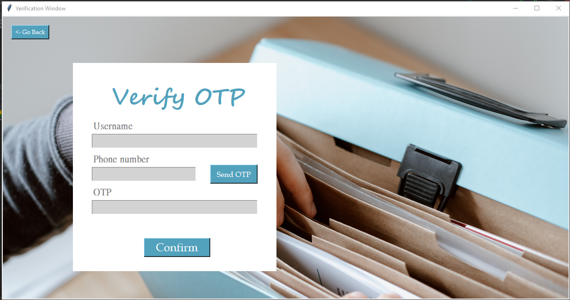
Verification Window

Slide 15
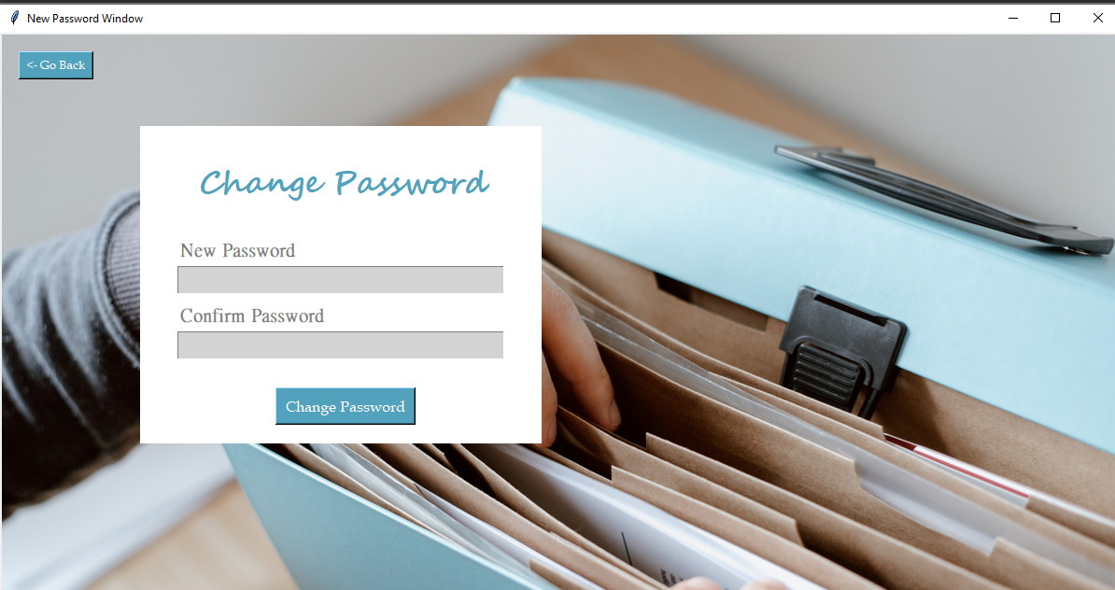
New Password Window

Slide 16
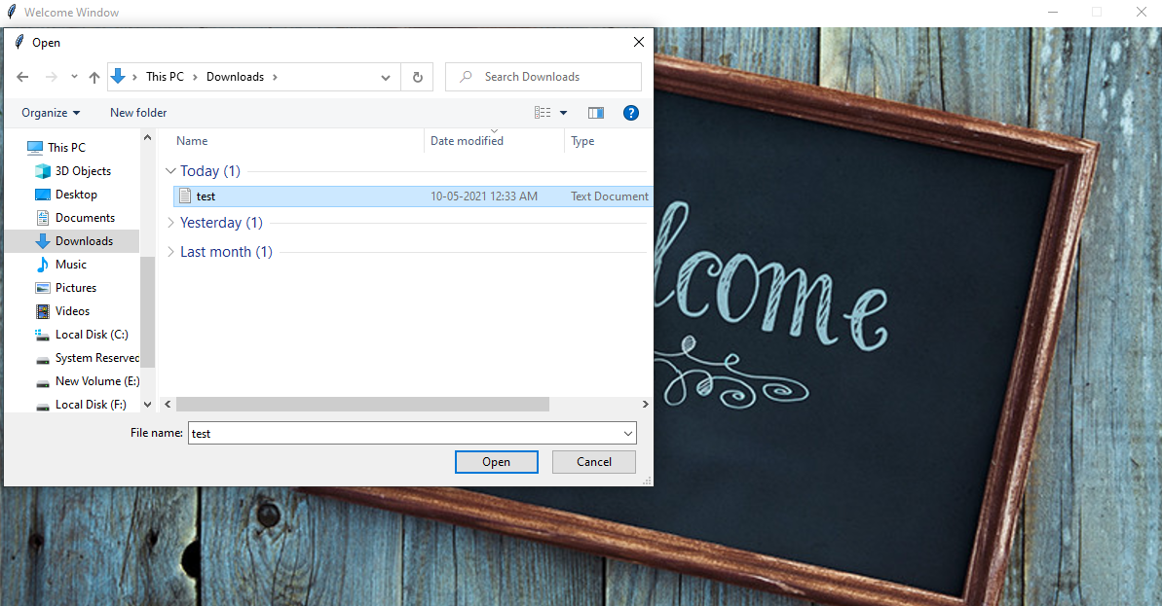
File Selection

Slide 17
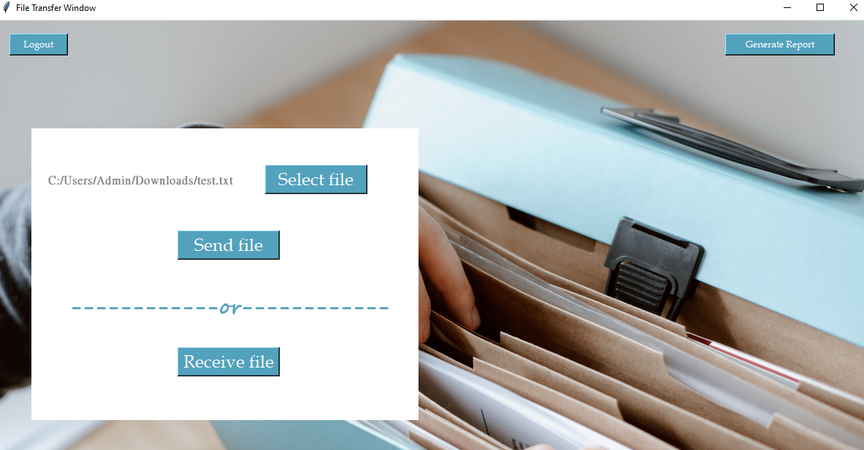
File Transferring Window

Slide 18
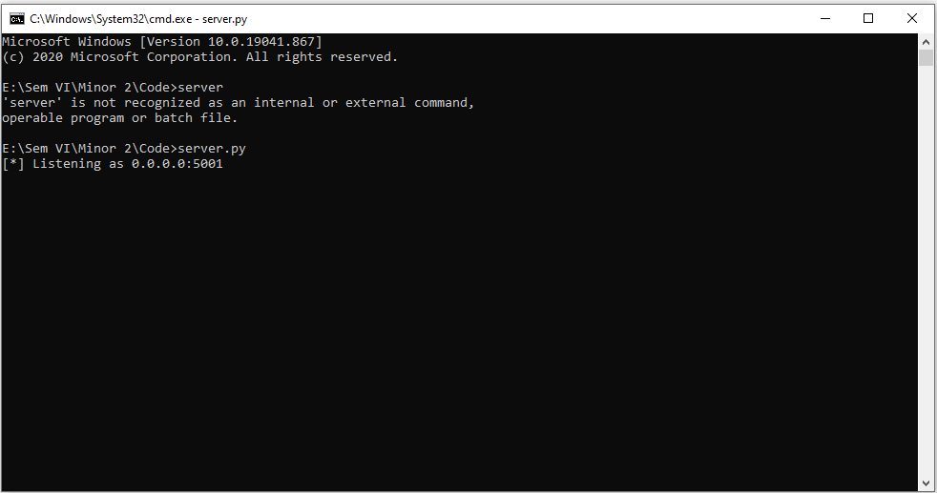
Server

Slide 19
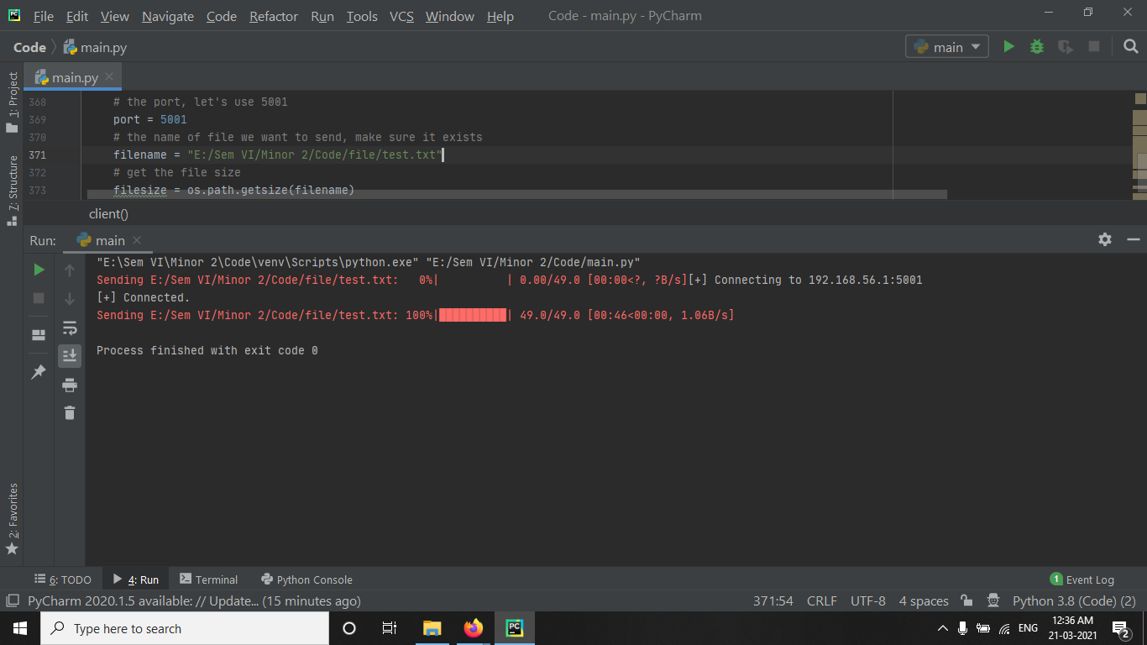
File transfer completion

Slide 20
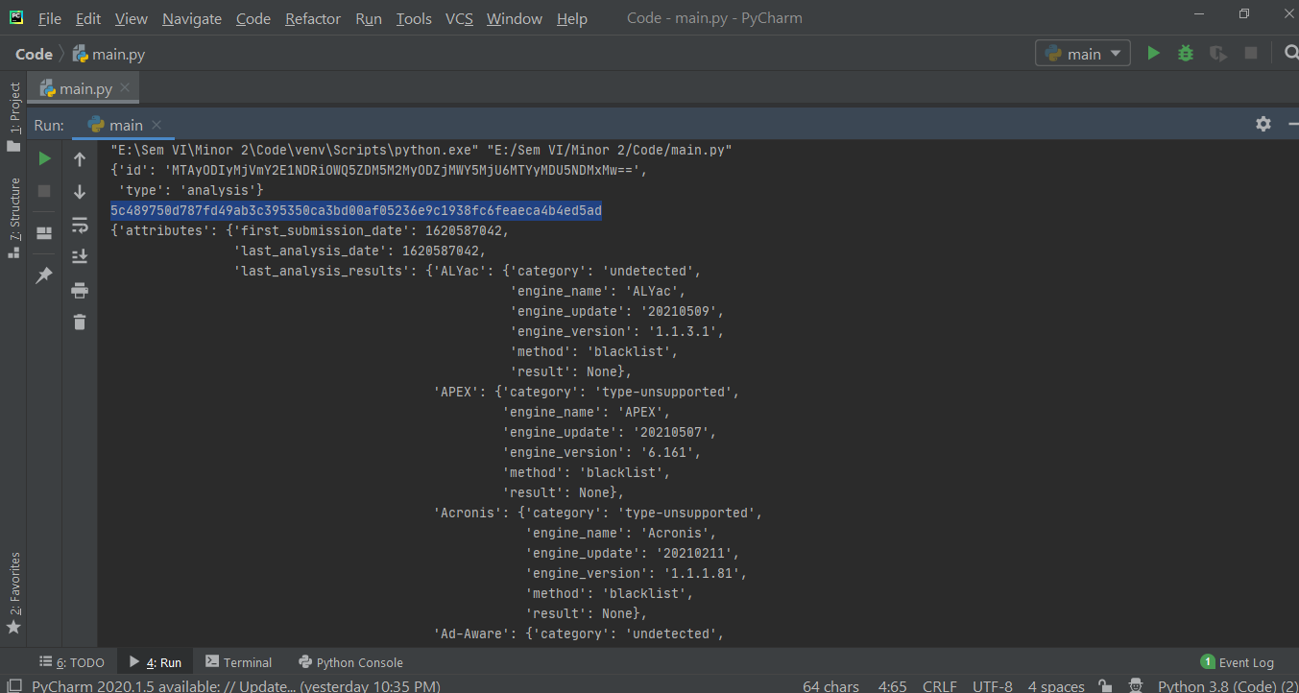
VirusTotal Report

Slide 21
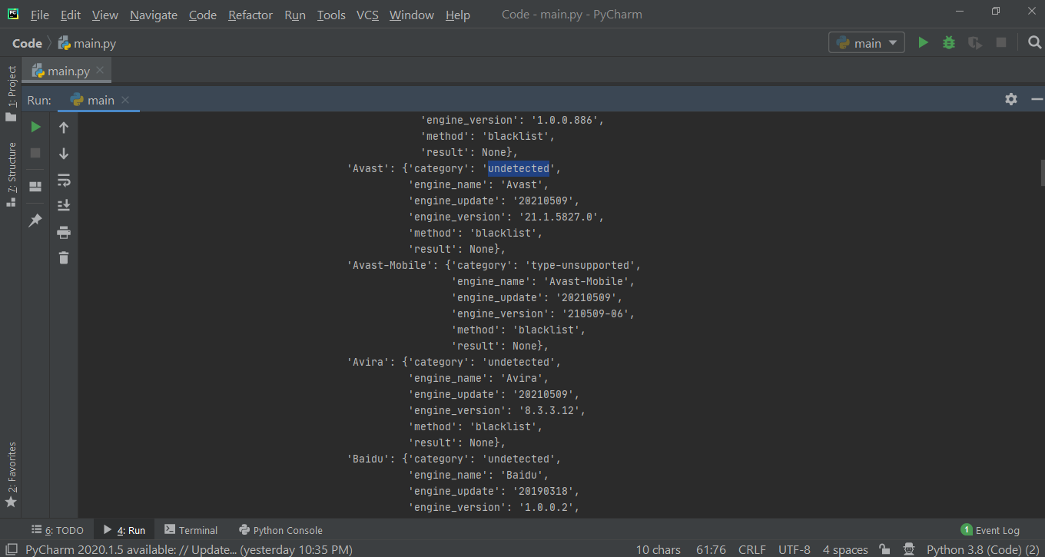

Slide 22
